Slide 1
GREATER ACCESS TO AFFORDABLE EDUCATION THROUGH FINANCE
Andrea Santiago, Akshitha Singathi, Raymond Otoadese, Noelia Vazquez

Slide 2

What is social Finance?
Inventors are looking for ways to finance their money and make an impact in society.
They believe in social responsibility which is an obligation to take care of the needs and interest of society while maximizing shareholder value.
A way to support and support change is through Social Finance
“Social finance is a term used to describe a range of financial products and services that have a social or environmental purpose”[2]

Slide 3

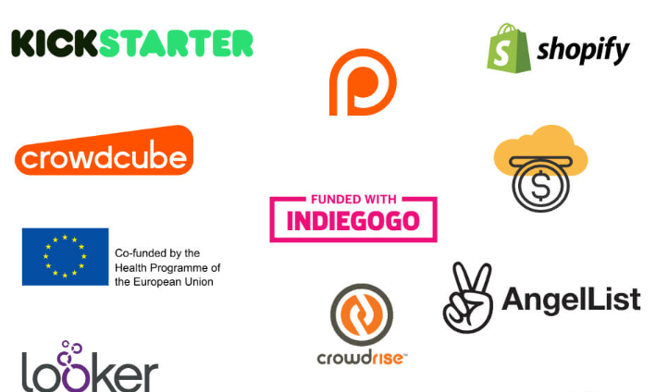
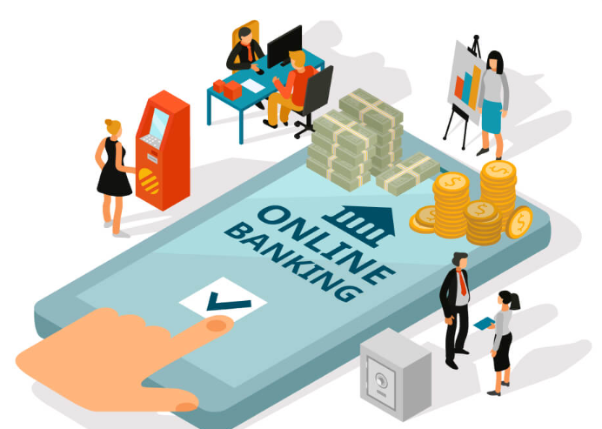

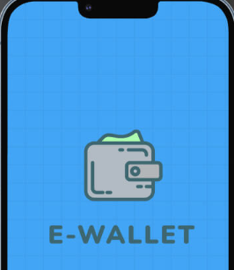
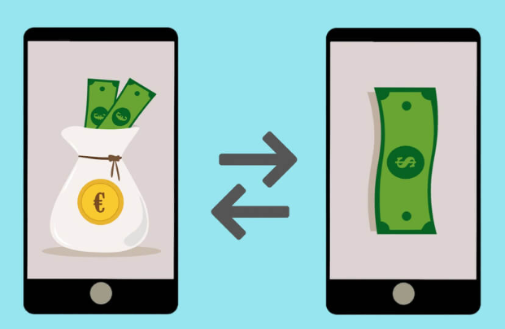
FINTECH MARKET AND ITS PRODUCTS
The Financial Technology (FinTech) Industry has seen enormous growth and has captured more impact-related investment funds than any other industry.
It has attracted the attention of many stockholders who want to invest in new business ideas.
The value of the FinTech companies in the United States generated 79 billion US dollars of value
Some popular FinTech products (apps) are: digital banking, Investment, P2P Payment, Insurance, Money savings, Crypto exchange platform, RegTech Apps, and crowdfunding.
[5]
[5]

Slide 4

A promising investment trend to focus on is crowdfunding. Through crowdfunding, people can raise money with the help of friends, family, individual investors, or customers.
[4]
The market of crowdfunding is expected to reach $300 billion by 2025, and some projects are expected to generate 17.2 billion per year (Kishore, 2022).

Slide 5


EDUCATION A MARKET TO FOCUS ON!
Americans believe college costs hold people back from pursuing higher education
In a survey done by the NORC, 75% cannot afford the cost of college 30%
A big concern for students is student debt. Only 8% of students are confident that they will successfully be able to pay for college
Grants and scholarships are available to help fund educational costs however it is not enough
40% of crowdfunding investments are focused on business and entrepreneurship, while only 20% focus on social causes (Stevanovic, 2022).
[2]
[3]

Slide 6
References: Slide 1-5
AppStudio. (2022, February 15). Successful fintech startup ideas to consider in 2022. AppStudio. Retrieved November 20, 2022, from https://www.appstudio.ca/blog/successful-fintech-startup-ideas/#Crowdfunding_Applications [4]
Bulger, Z., & Rouen, E. (2022, July 15). How fintech can deliver on its social impact promises. Harvard Business Review. Retrieved November 27, 2022, from https://hbr.org/2022/07/how-fintech-can-deliver-on-its-social-impact-promises [3]
Croll, D. (2022, September 18). What is Social Finance? Data in Finance. Retrieved November 25, 2022, from https://www.datainfinance.info/what-is-social-finance/ [2]
Jacobson Snyder, A. (2022, October 11). More than 3 in 4 Americans believe college is difficult to afford. Morning Consult. Retrieved November 22, 2022, from https://morningconsult.com/2022/10/11/college-affordability-student-loans-survey-data/
Kishore, K. (2022, September 30). Crowdfunding app development - cost and key features. OctalIT Blog. Retrieved November 22, 2022, from https://www.octalsoftware.com/blog/crowdfunding-app-development/ [5]
Redlin, P. (2022, August 24). Students are worried about paying for college. Edvisors. Retrieved November 26, 2022, from https://www.edvisors.com/blog/students-are-worried-about-paying-for-college/
Stevanovic, I. (2022, March 17). 40+ crucial crowdfunding stats in 2022. SmallBizGenius. Retrieved November 26, 2022, from https://www.smallbizgenius.net/by-the-numbers/crowdfunding-stats/
ESG. (n.d.). What is social responsibility to investors? ESG. Retrieved November 25, 2022, from https://www.esgthereport.com/what-is-social-responsibility-to-investors/
Images:
[1]9 Tips for Starting a Successful Crowdfunding Campaign (ideaplotting.com)
[2]More Than 3 in 4 Americans Believe College Is Difficult to Afford - Morning Consult
[3]The Importance of Higher Education | Why Does It Matter? (gradehacker.com)
[4]What is Crowdfunding Investment? - MyMoneySouq Financial Blog
[5]What is fintech and how is it changing financial products | Central Bank of Ireland | Central Bank of Ireland
[6]Most Successful Fintech Startup Ideas in 2022 (appstudio.ca)

